Slide 1
Research on Blind Deblurring
Yunzhe Cao, Zijian Qiao, Yifeng Huang and Shangru Huang

Slide 2
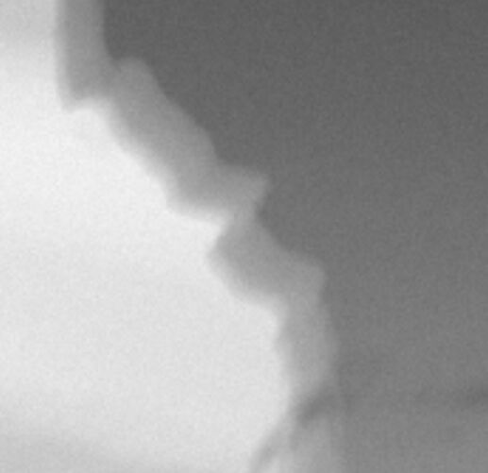
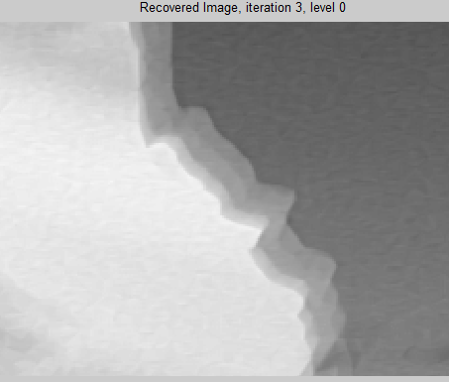
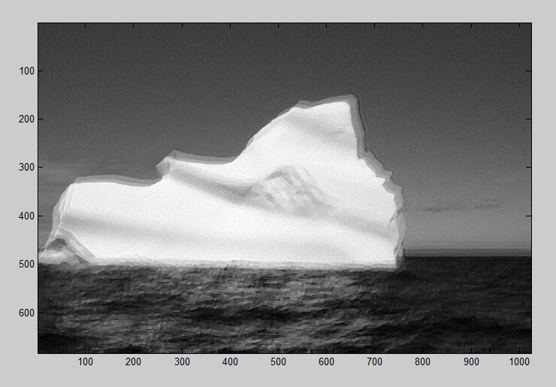
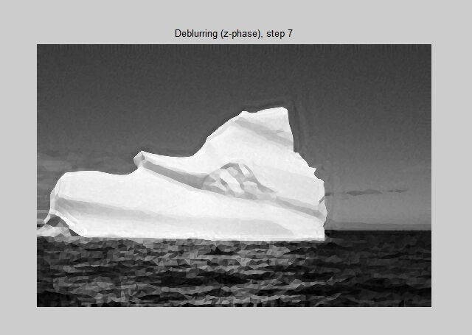
EPLL (Expected Log Likelihood):
Un-blind kernel
Bad performance
Algorithm from Paper:
kernal size running time
9 * 9 ≈ 10 min
51 * 51 > 45 min
Kernel: 9 * 9, edge is sharper but still blur
Kernel: 51 * 51 (still small), picture is clear but still has blocks
Reference: http://www.wisdom.weizmann.ac.il/~vision/BlindDeblur.html

Slide 3
Problems
Link error when converting from c/c++ to matlab (in Mac)
Compile error from encapsulated code

